Slide 1
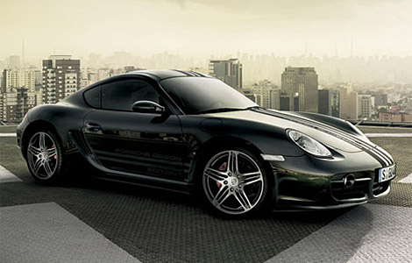
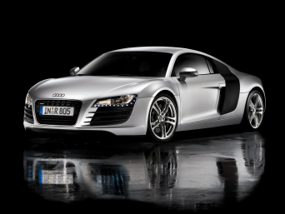
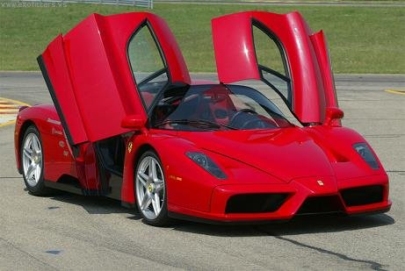
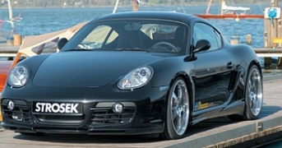
HEAT ENGINE &
Combustion of biodiesels
part 7
Notes:
Source: ap06/p1/thermal/ptG_engines.ppt

Slide 2
Today’s objectives:
To verify energy content of various fuels.
To compare regular diesel to biodiesel.
To explain how a diesel fuel engine work.
To understand the Otto cycle and apply its process to heat exchanges.
To calculate the efficiency of various engines.
To explain how a 4 stroke engine process work.

Slide 3
Part 1:
Carnot
Heat Engines

Slide 4
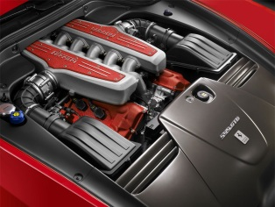
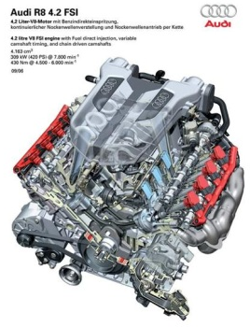
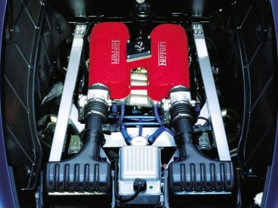
Heat engine: device that transforms heat partly into work (mechanical energy) by a working substance undergoing a cyclic process.

Slide 5
petrol engine: fuel + air

Slide 6
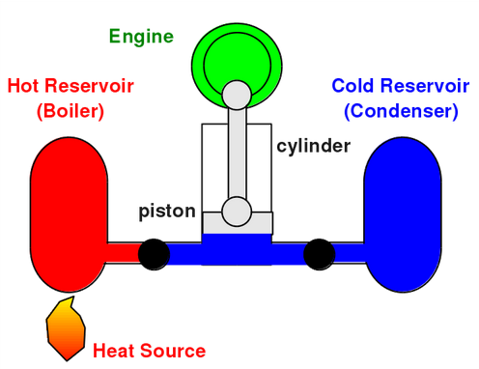
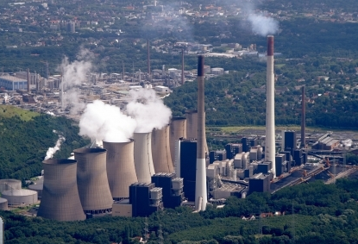
EXTERNAL COMBUSTION
All heat engines absorb heat Q_{H} from a source at a relatively high temperature (hot reservoir T_{H}), perform some work W and reject some heat Q_{C} at a lower temperature (cold reservoir T_{C}).
⇒ Q_{net} = |Q_{H}| - |Q_{C}| = W
Example of a fossil fuel electrical plant.
Notes:
Source: http://www.eoearth.org/view/article/152840/

Slide 7
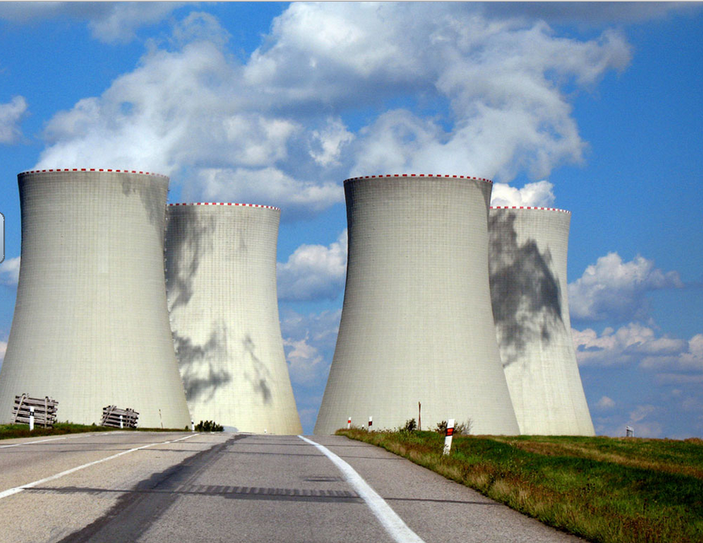
Notes:
Source: http://bradleydibble.authorsxpress.com/tag/cooling-towers/

Slide 8
Thermal efficiency, e represents the fraction of Q_{H} that is converted to useful work.
This is the absolute max efficiency of a heat engine.
e = 1 – T_{C} / T_{H} < 1

Slide 9
Efficiency of various heat engines
Car engines 20% to 25%
Fossil fuel plants 20% to 40%
Diesel heat engines: 20% to 40%

Slide 10
Hot Reservoir
Q_{H}
W
Engine
Surroundings
Q_{C}= 0
A heat engine can never be 100% efficient in converting heat into mechanical work.
Second Law of thermodynamic?

Slide 11
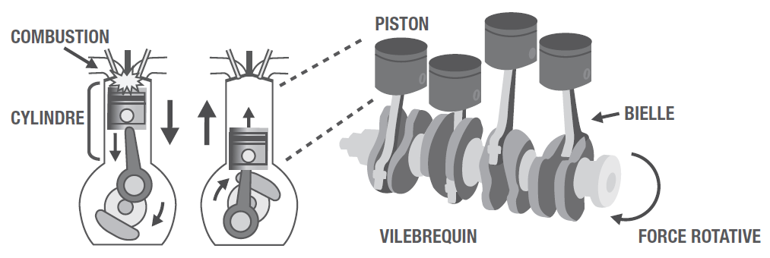
Fuel engines
Chemical Potential Energy→ Thermal energy→ Kinetic energy
Regular fuel engines.
http://auto.howstuffworks.com/engine1.htm
http://www.youtube.com/watch?v=r96tepCk17w&feature=related

Slide 12
Two strokes engine
http://science.howstuffworks.com/transport/engines-equipment/two-stroke2.htm
Lawnmowers
Garden equipment (chain saws, leaf blowers, trimmers)
Dirt bikes
Mopeds
Jet skis
Small outboard motors

Slide 13
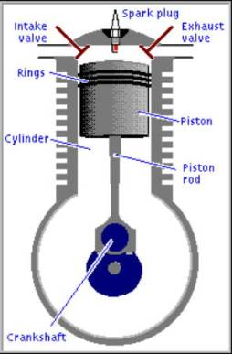
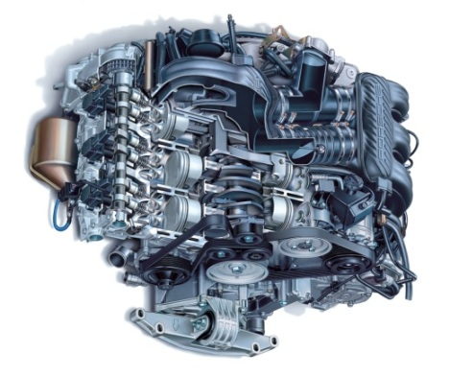
CAR ENGINE
INTERNAL COMBUSTION
The four–stroke OTTO cycle of a conventional petrol engine

Slide 14
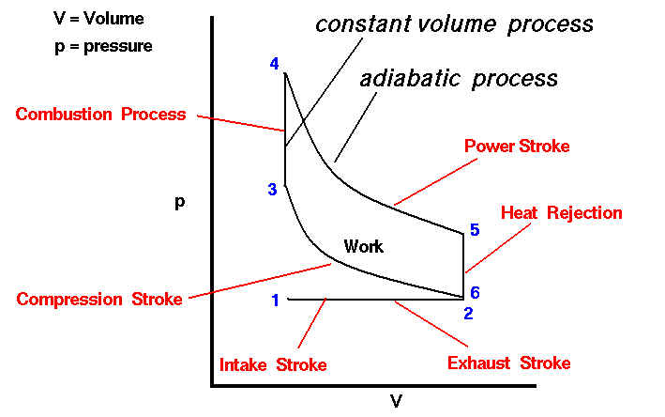
Notes:
Source: http://www.grc.nasa.gov/WWW/k-12/airplane/otto.html

Slide 15
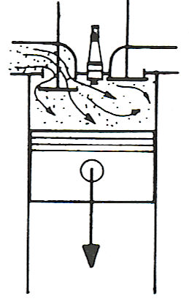
P
Otto Cycle
3
adiabatic
isothermals
Q
H
2
4
Q
C
released to
P
5
1
surroundings
o
V
V
V
2
1
5 → 1: inlet stroke volume increases as piston moves down creating a partial vacuum to aid air/fuel entering cylinder via the open inlet valve.

Slide 16
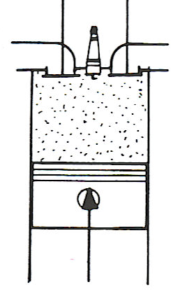
P
Otto Cycle
3
adiabatic
isothermals
Q
H
2
4
Q
C
released to
P
5
1
surroundings
o
V
V
V
2
1
1 → 2: compression stroke inlet valve closes piston moves up compressing the air/fuel mixture adiabatically.

Slide 17
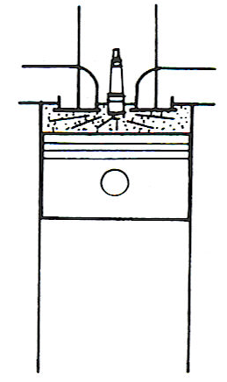
P
Otto Cycle
3
adiabatic
isothermals
Q
H
2
4
Q
C
released to
P
5
1
surroundings
o
V
V
V
2
1
2 → 3: ignition – spark plug fires igniting mixture - constant volume combustion.

Slide 18
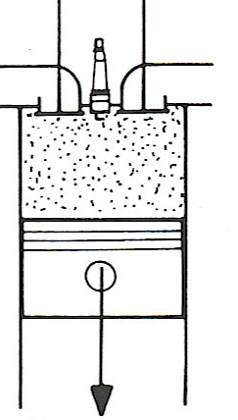
P
Otto Cycle
3
adiabatic
isothermals
Q
H
2
4
Q
C
released to
P
5
1
surroundings
o
V
V
V
2
1
3 → 4: expansion or power stroke – heated gas expands adiabatically as the piston is pushed down doing work
(V_{max} = r V_{min}). Compression ratio, r

Slide 19
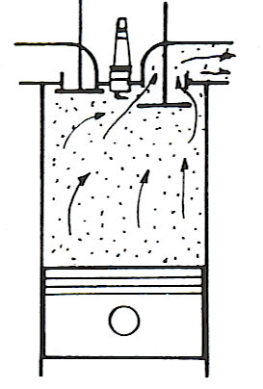
P
Otto Cycle
3
adiabatic
isothermals
Q
H
2
4
Q
C
released to
P
5
1
surroundings
o
V
V
V
2
1
4 → 1 start of Exhaust stroke – outlet valve opens and mixture expelled at constant volume then 1 → 5

Slide 20
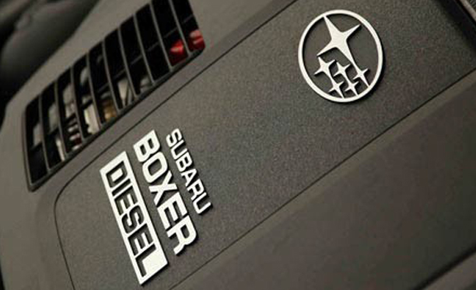
Diesel engine
http://www.youtube.com/watch?v=1hamvuWLomc
Source: http://blog.caranddriver.com/2009-subaru-impreza-forester-diesel-car-news/
Notes:
Source: http://blog.caranddriver.com/2009-subaru-impreza-forester-diesel-car-news/

Slide 21
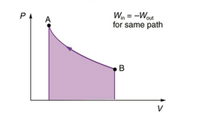
$PRESSURE ∙ VOLUME=Pa∙m^{3}$ = $\frac{N}{m^{2}}∙m^{3 }$= N∙m = Joule
The work done on a gas is the area under a PV curve.

Slide 22
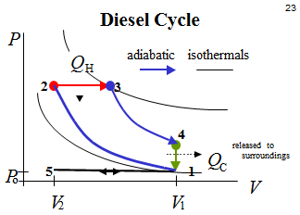
Diesel Cycle
P
Q
adiabatic
isothermals
H
2
3
4
released to
Q
surroundings
P
5
1
C
o
V
V
V
2
1

Slide 23
Diesel engines
Harder to start (especially in cold temperatures)
More efficient than petrol engines (higher compression ratios).
No pre-ignition of fuel since no fuel in cylinder during most of the compression.
They need no ignition system, but the fuel-injection system requires expensive high-precision machining.
(NO SPARK PLUG)

Slide 24
Part 2: Combustions of Fuels

Slide 25
The reason why fossil fuels are such a precious source of fuel is that a lot of energy can be produced from a relatively small amount of it.
The energy of the fuel source is stored within the bonds of the molecules as chemical potential energy.

Slide 26
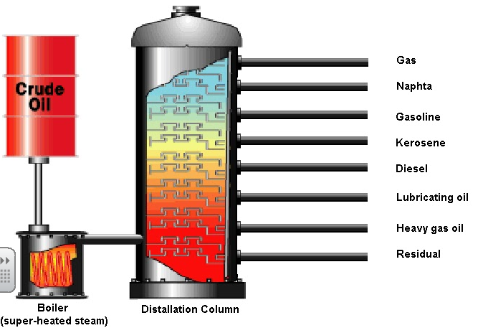
Notes:
Source: http://expeditieaarde.blogspot.ca/2013_01_01_archive.html

Slide 27


Slide 28
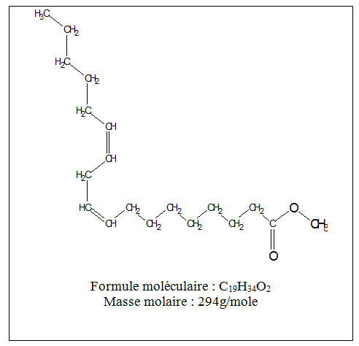
Biodiesel molecule from soya oil

Slide 29
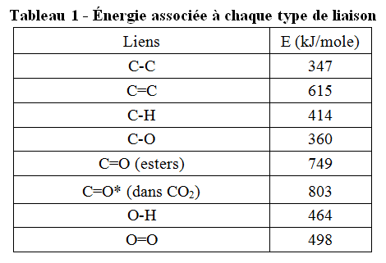

Slide 30
Carburant | Chaleur de combustion (kJ/mole) | Masse molaire (g/mole) | Chaleur de combustion massique (kJ/g)
Éthanol
Octane (essence)
Biodiésel | 11 113 | 294 | 37.8

Slide 31
Carburant | Chaleur de combustion (kJ/mole) | Masse molaire (g/mole) | Chaleur de combustion massique (kJ/g)
Éthanol | 1261 | 46 | 27.4
Octane (essence)
Biodiésel | 11 113 | 294 | 37.8

Slide 32
Carburant | Chaleur de combustion (kJ/g) | Masse volumique (g/mL) | Chaleur de combustion volumique (kJ/mL)
Éthanol | 27.4 | 0.79 | 21.6
Octane (essence) | 44.7 | 0.70 | 31.3
Biodiésel | 37.8 | 0.88 | 34.9
L’éthanol contient moins d’énergie par litre. Il faut donc un volume supplémentaire (en litres) pour parcourir la même distance avec un véhicule (environ 30% de plus).

Slide 33
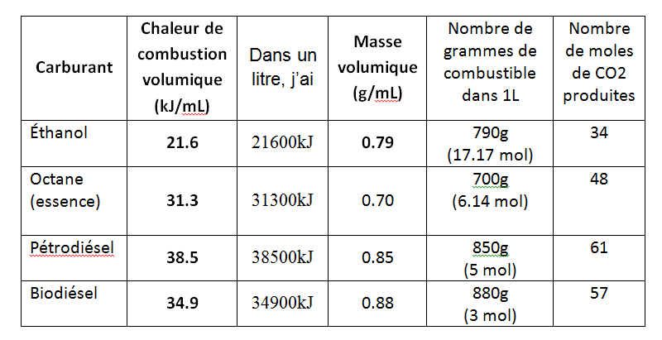
Par contre, même s’il faut plus d’éthanol (30% de plus environ) pour un rendement énergétique égale, l’éthanol produit UN PEU MOINS de dioxyde de carbone que l’octane.

Slide 34
Type of fuel | Content required | Type of biofuel | Date of regulation
Fuel | 5% | Ethanol | December 15th 2010
Diesel and heating crude oil | 2% | Biodiesel | July 1st 2011 January 2013 (Québec et maritimes)

Slide 35

1350km on a tank?
Look at the new TDI Passat http://web.vw.com/tdi-clean-diesel/

Slide 36
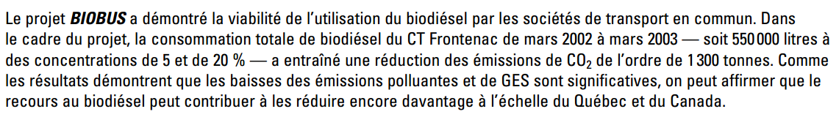
Savais-tu?
For more info: http://www.mouvementcollectif.org/wp-content/uploads/2009/05/le-biodiesel-biobus-rapportfinal-lien1-fr.pdf

Slide 37
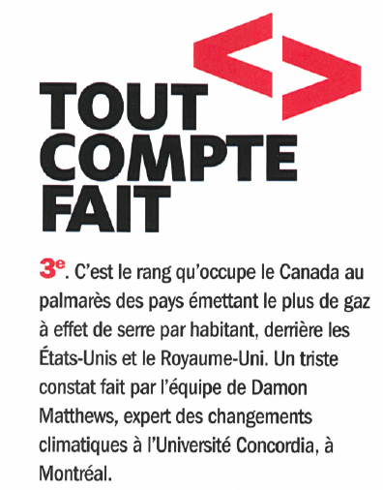


Slide 38
